Slide 1
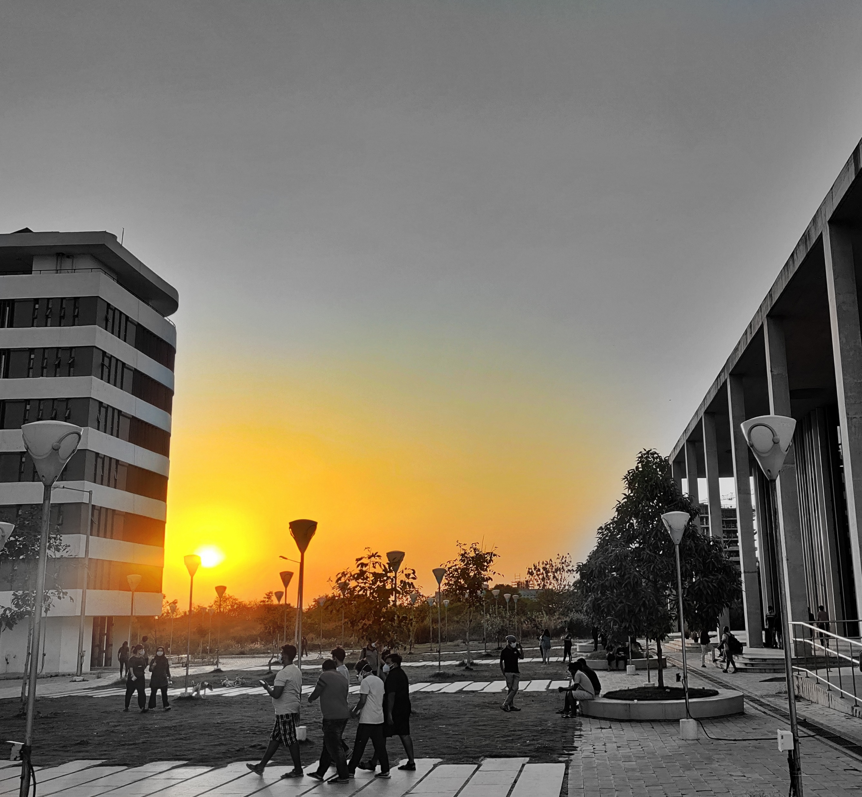
Inventing & Innovating in Technology for Humanity (IITH)

Slide 2
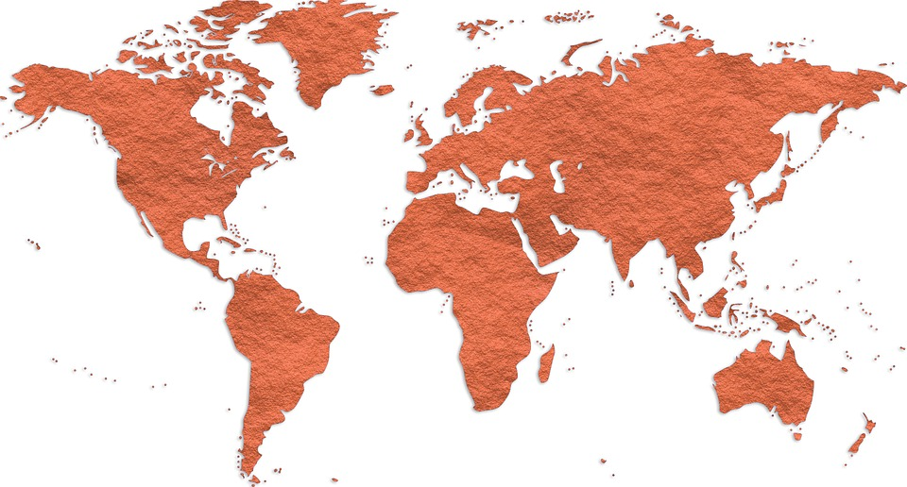
HYDERABAD, TELANGANA, INDIA
HYDERABAD
ABOUT HYDERABAD
Hyderabad is the capital of southern India’s Telangana state. A major center for the technology industry, it’s home to many upscale restaurants and shops. At over 12.2 million, it has the largest population of any city in the state. It is also known as the city of pearls. IITH campus is in Kandi, Sangareddy district in Telangana.

Slide 3
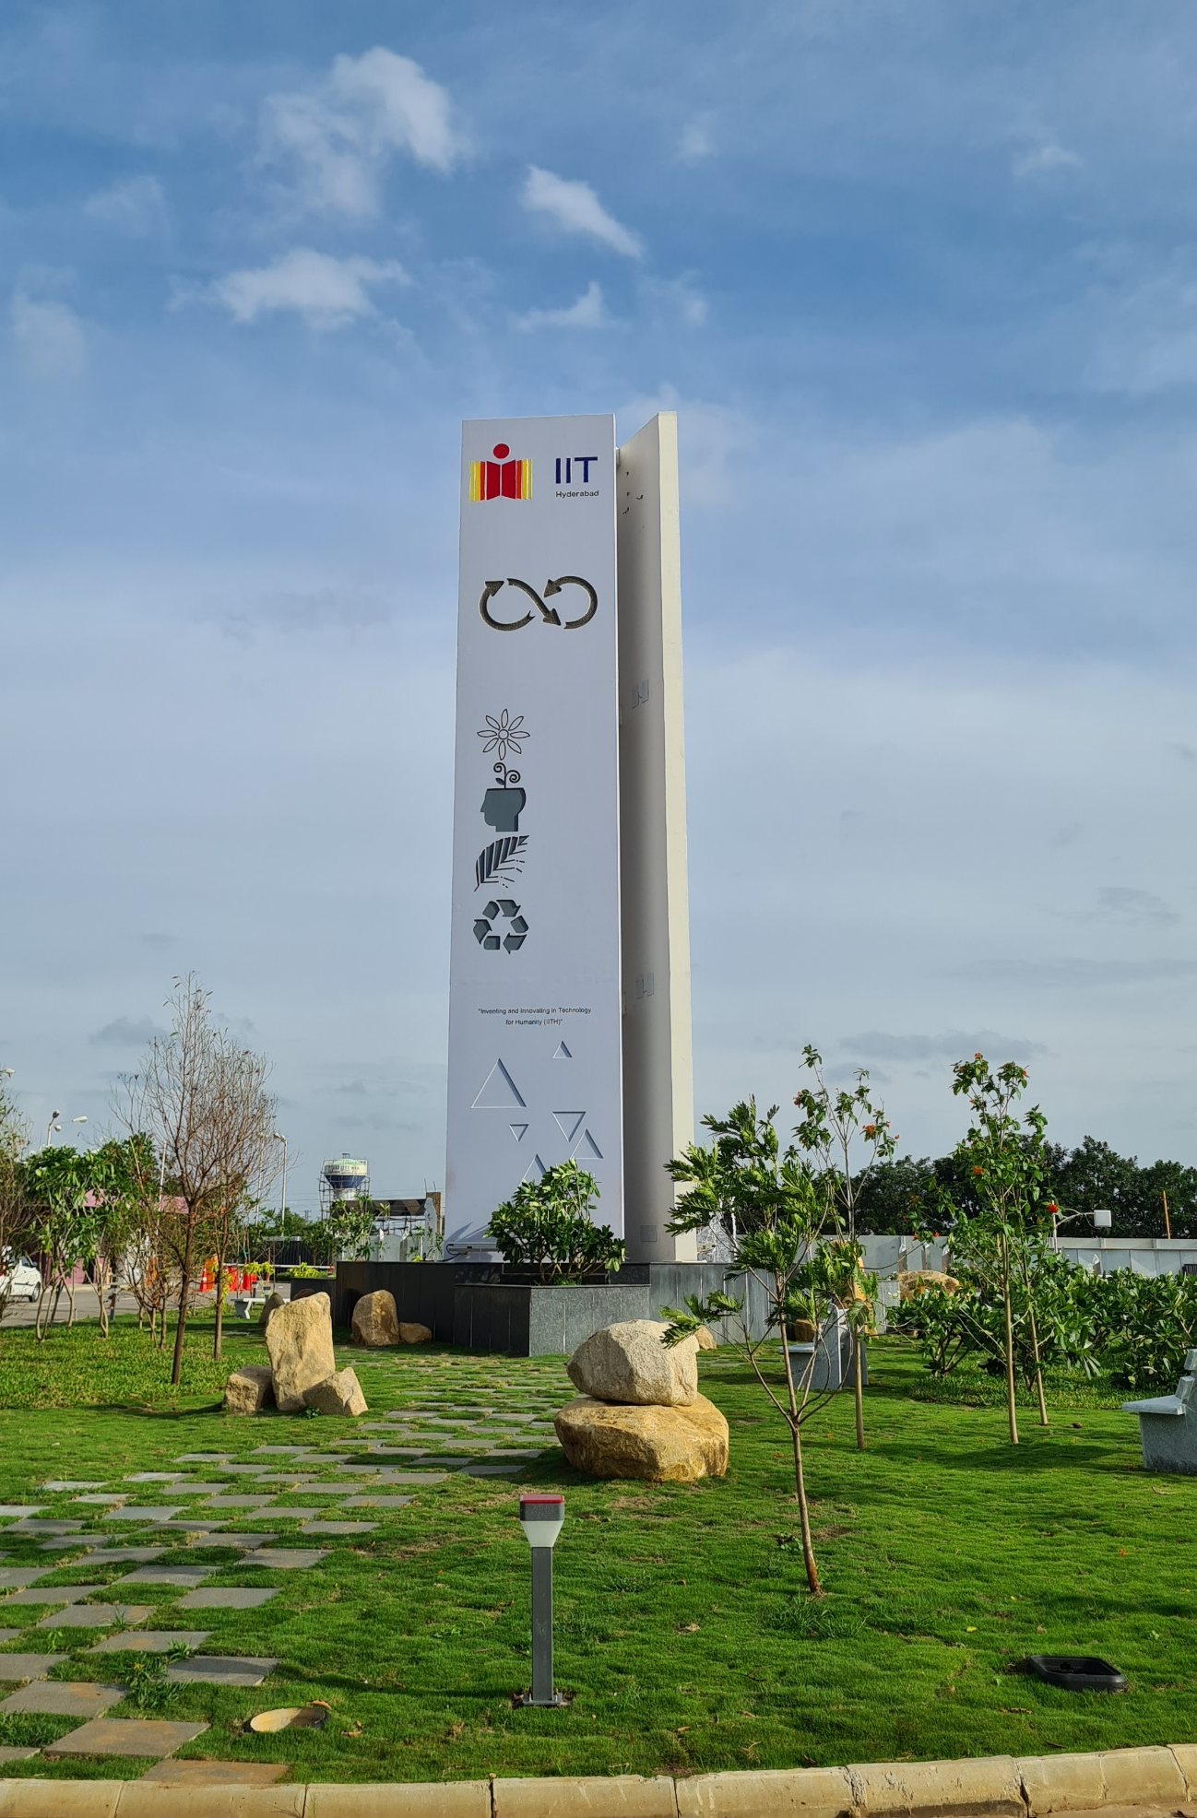
IITH, A Dream Destination for Students, Academicians, Researchers & Industries
VISION
MISSION
IITH will be the cradle for inventors and innovations. It will advance knowledge and scholarship to students in science, technology and liberal arts, and equip them to handle the challenges of the nation and the world in 21st century
To be recognized as ideators and leaders in higher education and research, and to develop human power with creativity, technology and passion for the betterment of India and humankind

Slide 4
A GLANCE AT IIT HYDERABAD
Indian Institute of Technology Hyderabad (IITH) is a 2nd generation premier institute of science and technology established in 2008.
IITH has been consistently ranked in the top 10 institutes in India for Engineering according to NIRF making it one of the most coveted schools for science and technology in the country.
IITH creates a unique holistic ecosystem for education that offers interactive learning, a very flexible academic structure, cutting-edge research, strong industry collaboration, and entrepreneurship.
IITH enjoys a very special relationship with Japanese universities and industries that goes beyond academic and research collaborations.
The campus is spread across 570 acres with some of the iconic buildings that will carry the signature of Japanese architecture.
4272 Students - ( 1187 PhD, 1300 PG, 1785 UG)
270+ Faculty
270+ Staff
19 Departments
200+ Patents
7 Online MTech+ Online MDes
8 Industry-oriented MTech Programs with industry-defined problems as MTech Projects
8 Centers of Excellence
9 Research and incubation centres
100+ Start-ups
7500 + publications
534 cr+ research funding

Slide 5
DEPARTMENTS
ENGINEERING
SCIENCE
LIBERAL ARTS, DESIGN,
AND MANAGEMENT
Artificial Intelligence
Biomedical Engineering
Biotechnology
Chemical Engineering
Climate Change
Civil Engineering
Computer Science and Engineering
Electrical Engineering
Engineering Science
Heritage Science and Technology
Materials Science and Metallurgical Engineering
Mechanical & Aerospace Engineering
Computational Engineering (Interdisciplinary)
Chemistry
Physics
Mathematics
Liberal Arts
Design
Entrepreneurship and Management

Slide 6
ACADEMIC PROGRAMS
Under Graduate Programs
Bachelors of Technology (B.Tech)
Artificial Intelligence
Biomedical Engineering
Biotechnology
Chemical Engineering
Civil Engineering
Computer Science and Engineering
Electrical Engineering
Engineering Science
Materials Science & Metallurgical Engineering
Mechanical & Aerospace Engineering
Physics
Chemistry
Mathematics
Computational Engineering (Interdisciplinary)
Bachelors of Design (B.Des)
Post Graduate Programs
Master of Technology (M.Tech)
Artificial Intelligence
Biomedical Engineering
Biotechnology
Chemical Engineering
Civil Engineering
Climate Change
Computer Science and Engineering
Electrical Engineering
Entrepreneurship & Management
Heritage Science and Technology (Online)
Materials Science & Metallurgical Engineering
Mechanical & Aerospace Engineering
Master of Science (M.Sc)
Physics
Chemistry
Mathematics
Masters in Development Studies (MA)
Master of Design (M.Des)
Professional
IITH offer the following professional programs:
Master of Technology (Executive M.Tech) Biodesign
The Dept. of Biomedical Engineering offers an executive M.Tech. The program is an amalgamation of engineering and life sciences
Fellowship program
The Center for Healthcare Entrepreneurship (CfHE) offers a 12 months long fellowship program comprising of 30 credits of class room entrepreneurship training, including 8 weeks of clinical

Slide 7
RESEARCH PROGRAMS
All the departments (except Engineering Science) at IITH offer PhD program
IITH offers regular PhD programs in the following departments
Artificial Intelligence
Biomedical Engineering
Biotechnology
Chemical Engineering
Civil Engineering
Climate Change
Computer Science and Engineering
Engineering Science
Electrical Engineering
Heritage Science and Technology
Materials Science and Metallurgical Engineering
Mechanical and Aerospace Engineering
Chemistry
Physics
Mathematics and Computing
Liberal Arts
Design
Entrepreneurship and Management

Slide 8
INTERDISCIPLINARY (ID) PhD PROGRAM
IIT Hyderabad announces Interdisciplinary (ID) PhD program for enthusiastic aspirants exploring the interface of various science and engineering disciplines. The interdisciplinary PhD program is coordinated by the Center for Interdisciplinary Programs (CIP)
The ID PhD Program involves rigorous course work (12 or 24 credits depending on the background of students) followed by research work in their chosen area leading to a doctoral thesis.
The Institute has formalized "Four" research areas as part of CIP interdisciplinary PhD program. The full list of interdisciplinary research projects can be found below.
Novel Materials & Techniques
Energy, Environment & Creative Design
Bioengineering & Healthcare
Artificial Intelligence, Communications & Networks

Slide 9
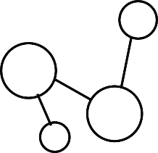
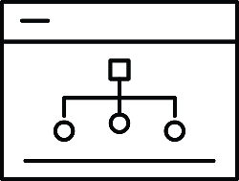
RESEARCH THRUST AREAS
5G and Next Generation Communication Technologies
Additive Manufacturing
Artificial Intelligence
Bio-Inspired Processes and Systems
Catalysis
Climate Change
Energy
Health Care
Integrated Computational Engineering
Nano-Technology
Sensors and Devices
Waste Management
Smart Mobility
Transportation
Rural Development
Robotics

Slide 10
Life on IITH Campus

Slide 11
INNOVATION AT IITH
IITH ENTREPRENEURSHIP ECOSYSTEM
GERMINATION
PREINCUBATION
INCUBATION
ACCELERATION
HOST
Entrepreneurship Cell
CfHE
Technology
Research Park
Minor in
Entrepreneurship
iTIC Incubator
FabCL
DEPARTMENT OF ENTREPRENEURSHIP AND MANAGEMENT
INSTITUTION’S INNOVATION COUNCIL
INTELLECTUAL PROPERTY CELL

Slide 12
iTIC
i-TIC Foundation is the Technology Business Incubator (TBI) at IITH. The focus is on creating a supportive and nourishing environment for entrepreneurs.
The thrust areas at the Incubator are Artificial Intelligence, Aerospace, Telecommunication, Digital Manufacturing, Chip Design, Sensors, IT, Bio-Medical, Automotive, Advanced Materials, Energy, Flexible Electronics, and Other Emerging Technologies. 70+ Startups supported, 5 Cr+ Funds Granted to Startups, 100 Cr+ Revenue Generated by Startups, 800+ Jobs created by the Startups, ~1.5 L SFT Incubation Space & 150+ Mentors.
To know more, visit: https://i-tic.iith.ac.in/
CfHE
The Center’s objective is to catalyze healthcare innovation to bring about affordable solutions to address the healthcare needs of India.
The Center hopes to foster entrepreneurs to deliver a pipeline of cost-efficient solutions, which are increasingly ‘commercialized’. Housed in a 6000 sq.ft., brand new facility, the CfHE incubator offers design and 3D fabrication facilities for prototyping of solutions and devices and serves as a rapid acceleration platform for the fellows and startups.
To know more, visit: https://cfhe.iith.ac.in/

Slide 13
FabCI
The Fabless Chip Design Incubator (FabCI) is a flagship program being executed with the support of the Ministry of Electronics and Information Technology (MEITY) and focuses on creating an ecosystem wherein these primary activities get executed for any startup in the area of chip design.
The primary motivation for this unique incubator program is to provide a one-stop solution for start-ups focusing on the area of chip design.
To know more, visit: http://fabci.iith.ac.in/
IITH TRP
IITH Technology Research Park is an independent Section 8 Company, founded, promoted, and hosted by IITH and is a self-reliant team endorsed by IITH and its alumni.
The IITH Research Park promotes the betterment of research and development by the institute through friendship with industry, helping in the advancement of modern ventures, and built-up economic development.
The IITH Research Park assists organizations with a research target to set up an infrastructure in the park and advantage of the expertise available at IITH. 1.5 L SFT Space was added recently to TRP at IITH.
To know more, visit: https://trp.iith.ac.in/

Slide 14
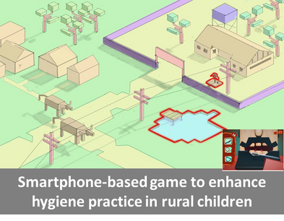
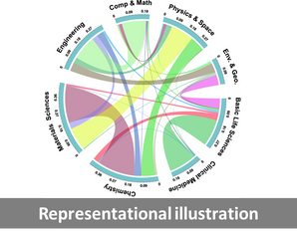
CENTERS OF EXCELLENCE (COE)
Rural Development Centre
Rural Development Centre (RDC) at IITH was established in July 2020 with a vision to support Rural development initiatives of the Government through innovative technologies being developed at IITH.
To know more, visit: https://rdc.iith.ac.in/
Centre for Interdisciplinary Program (CIP)
Center for Interdisciplinary Programs have been created with a vision of fostering interdisciplinary studies across various disciplines at IITH. We @IITH envision creating new paradigms in education integrating techniques, tools, and science from multi and cross-disciplinary expertise on the IITH campus.
To know more, visit: https://cip.iith.ac.in/

Slide 15
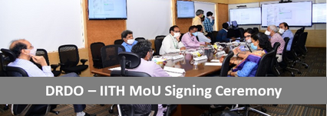
CCE
The Centre for Continuing Education (CCE) was established at IITH with the aim to conduct training programs to students, academicians, and working professionals across the country.
With a rapid rise in E-learning programs, CCE at IITH plans to conduct online programs that can facilitate the learning of working professionals by meeting their work schedules.
To know more, visit:
TLC: http://tlc.iith.ac.in/ ,
GIAN: https://www.iith.ac.in/~gian/
TEQIP: http://teqip.iith.ac.in /
IITH-DRDO Cell
An MOU has been signed between the Chairman, DRDO, and the Director, IITH, on 3 July 2020 or the establishment of the DRDO-IITH research cell at the IITH campus.
This Cell is an extension wing of the Research and Innovation Centre Chennai, a self-accounting unit of DRDO

Slide 16
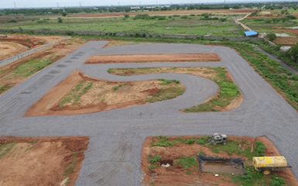
DST NM-ICPS TiHAN
Department of Science and Technology (DST) under the National Mission on Interdisciplinary Cyber-Physical Systems (NM-ICPS), Govt. of India has sanctioned the prestigious Technology Innovation Hub to IITH in the technological vertical of Autonomous Navigation and Data Acquisition Systems (UAVs, ROVs, etc.).
To know more, visit: https://tihan.iith.ac.in/
Design Innovation Centre
Design Innovation Centre at IITH is engaged in Innovation through design and technology along with partnering institutions engaging with mutually beneficial innovation activities.
To know more, visit: http://dic.iith.ac.in/
Test-tracks for Autonomous Vehicles
Virtual Reality of Medak Cathedral Church

Slide 17
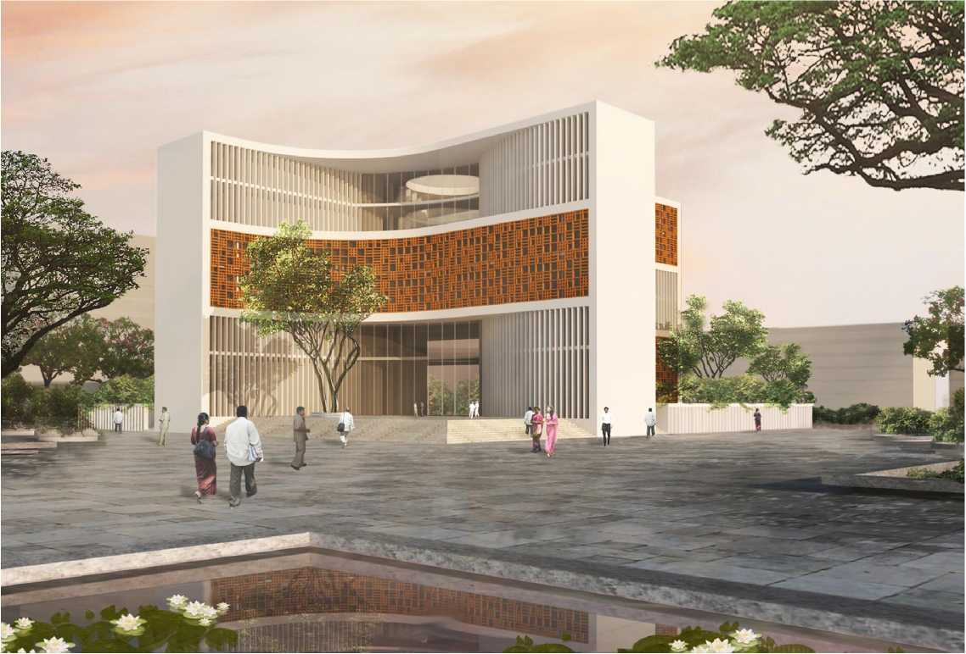
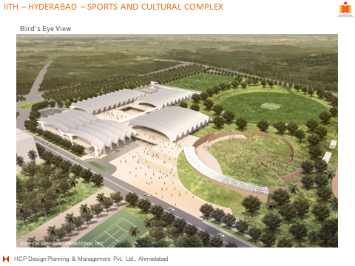
Alumni & Corporate Relations ( ACR)
Alumni Engagements
Alumni Meet & Greet @ major cities
Foster talks by alumni
IITH annual alumni day
IITH monthly digest to alumni
IITH AA engagements with students
IITH campus access facilities
Fundraising Activities
Legacy projects funding – alumni batches
Excellence awards endowment by alumni
Scholarships supported by alumni
Engaging with corporates for CSR funding
Fundraising campaign drives
Scholarship for EWS funded by NGOs
Administration Building
Sports & Cultural complex

Slide 18
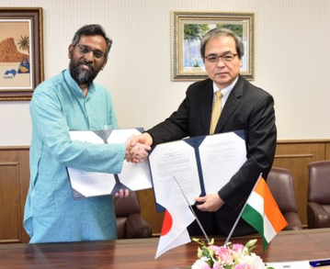
INTERNATIONAL RELATIONS
Roles & Responsibilities of International Relations
International Admissions and International Collaborations
Coordinate international delegation visits to IITH
Encourage, maintain and sustain relationships with foreign universities and build new partnerships
Promote International admissions in neighboring countries
Promote international student exchanges (both inbound and outbound)
Facilitate faculty exchanges and research collaborative workshops
We are focused on building strong research collaborations with foreign universities. To accomplish this, we envisage a
4-stage process:
Faculty interactions (visits & workshops, video-conferencing, joint proposals, co-authored papers)
Student exchanges (PhD and M.S. scholars to spend 3-6 months carrying out research at collaborators' laboratories)
Joint supervision of research scholars, serving on doctoral and master committees
Joint-degree programs (where sufficient sustainability and scalability of relations have been demonstrated)

Slide 19
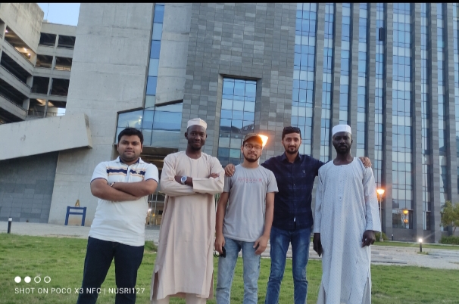
JOINT DOCTORAL PROGRAMS
IITH - SUT (Swinburne University of Technology), Australia
IITH - Deakin University, Australia
IITH– NTHU ( National Tsing Hua University), Taiwan
PARTNERS
INTERNATIONAL STUDENTS ADMISSION

Slide 20
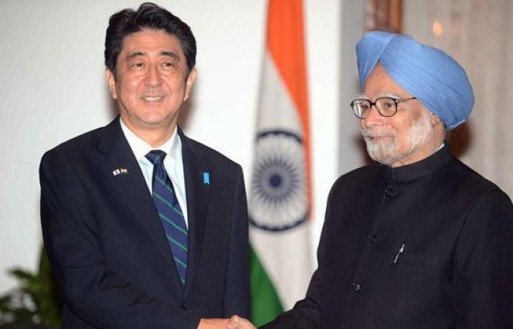
Japan-IITH…. JICA & Japan Desk
2007 2009
Japan committed to initiating a working group for setting up a new IIT in August 2007 as decided by the then Prime Ministers.
The bonding between IITH and Japan is strong, sustainable, and stable like the “Covalent Bond”
IITH has a very unique collaboration with Japanese universities and industries
Opportunities to study in Japan are one of the important aspects of the IITH-Japan Collaboration.
The aim is to strengthen the bilateral relationship between India and Japan through academia and industry
As a first step in building a sustainable platform for academic and industry-university collaboration between India and Japan, JAPAN DESK was established physically at IIT Hyderabad campus in Jan 2022 which will provide a one-stop service in academic and industry-university collaboration. It is aimed to operate independently even after the project is completed after six years.

Slide 21
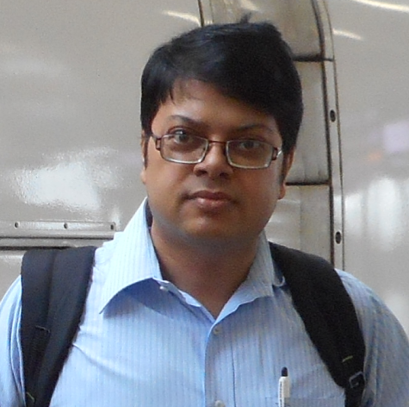
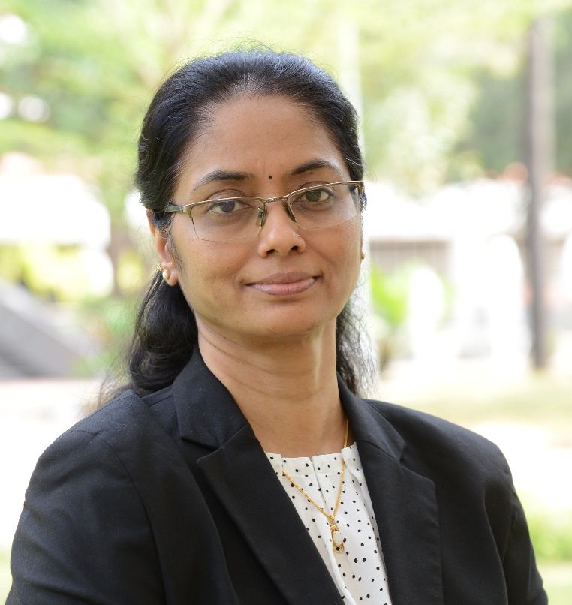
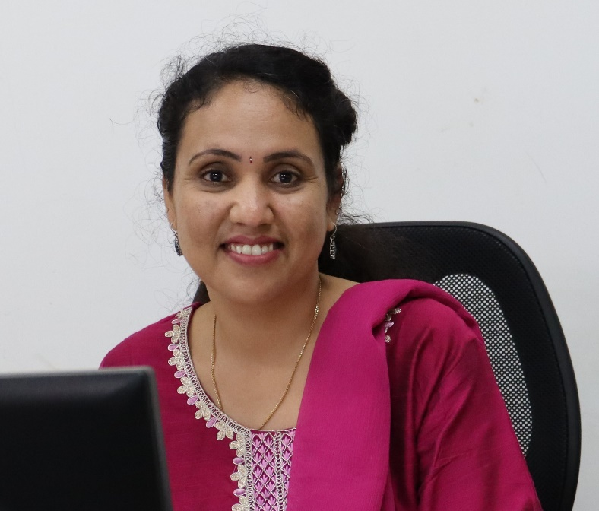
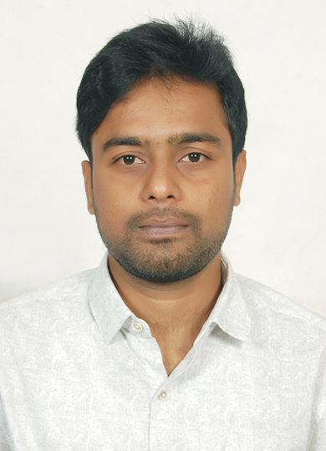
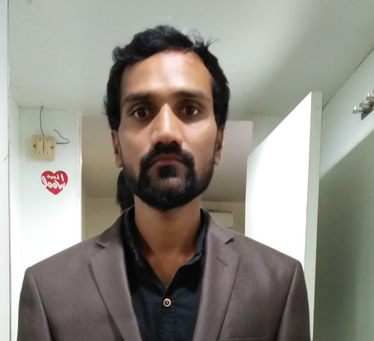
CONTACTS
Prof. Tarun Kanti Panda
Dean International Relations
Professor, Department of
Chemistry
Dean.ir@iith.ac.in
Office.ir@iith.ac.in
tpanda@chy.iith.ac.in
(040) 2301 - 6007
Ms. Kavitha G R
Lead International
Collaborations
Ic.ir@iith.ac.in
+91 9444536574
Mr. Azmath Ali
Manger Inbound programs
& International Admissions inbound.ir@iith.ac.in
ia.ir@iith.ac.in
Ms. A. Pranitha
Manager Outbound programs & Japan desk outbound.ir@iith.ac.in
Japandesk.ir@iith.ac.in
Mr. Reegan
Office Assistant

Slide 22
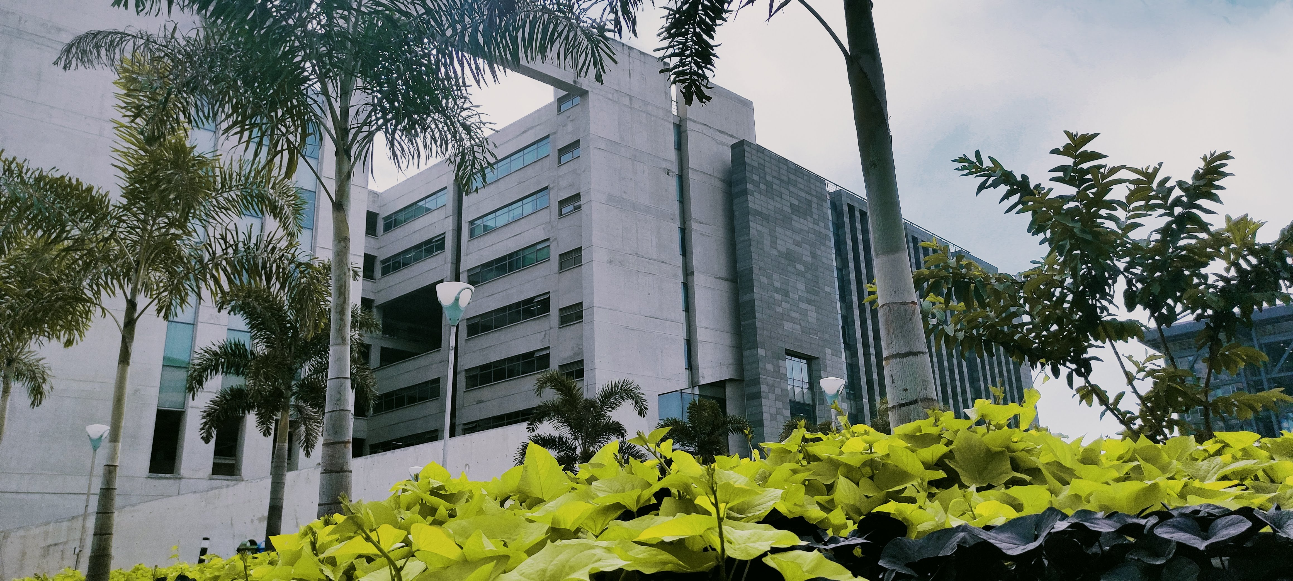
OFFICE OF INTERNATIONAL RELATIONS
IIT HYDERABAD

